Slide 1
About Coding
My tips on coding

Slide 2
Things to know
Compiler
Interpreter
IDE (Integrated Development Environment) or Code Editor
Data Types
Execution of code

Slide 3
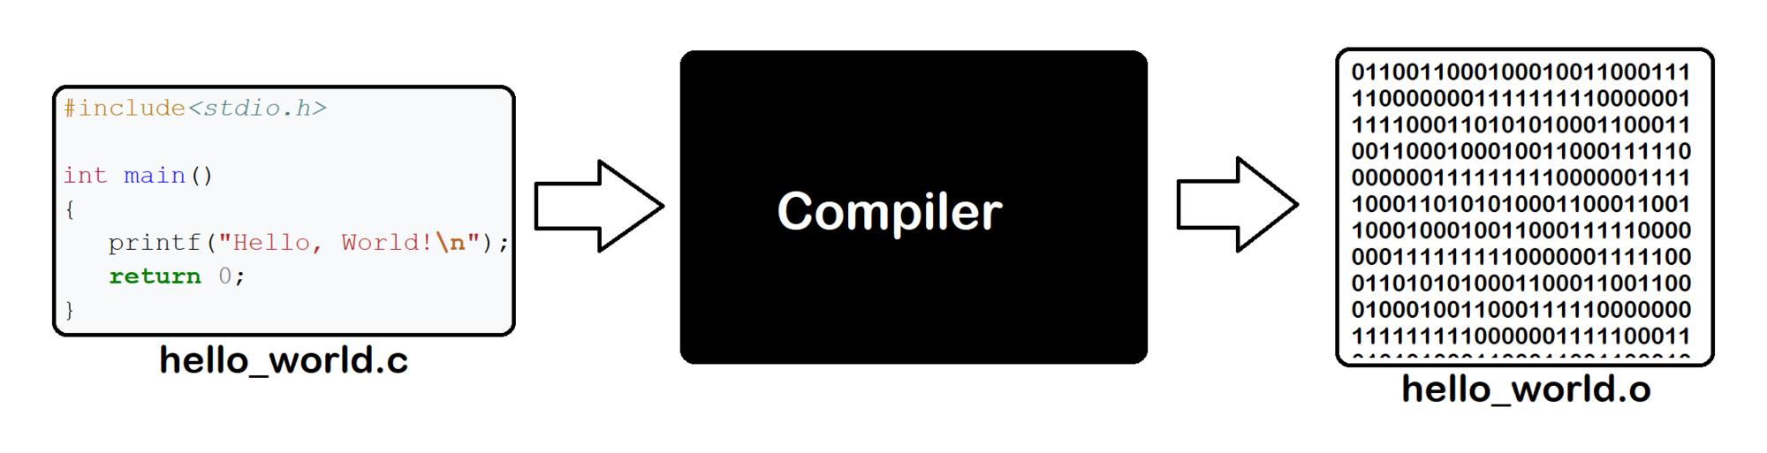
1)Compiler
Creates binary file
Convert program in to 1 and 0
Fast runtime
Takes time to build

Slide 4
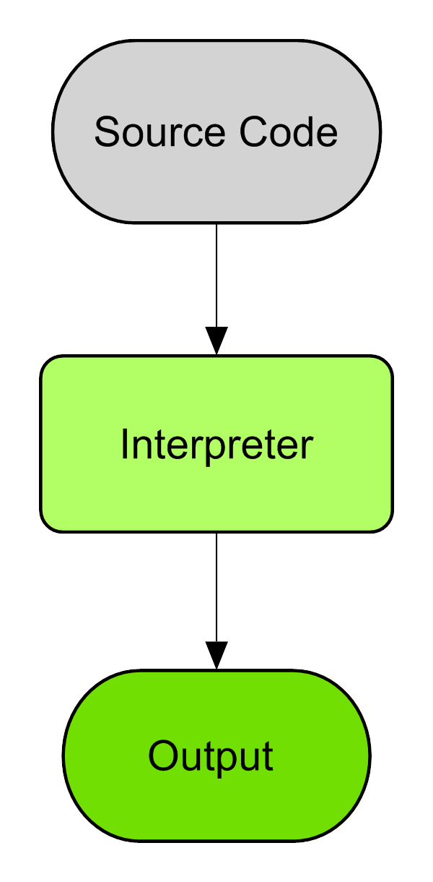
2) Interpreter
Doesn’t create binary file
Reads the code and executes
Slow runtime
No Build

Slide 5
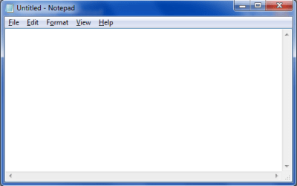
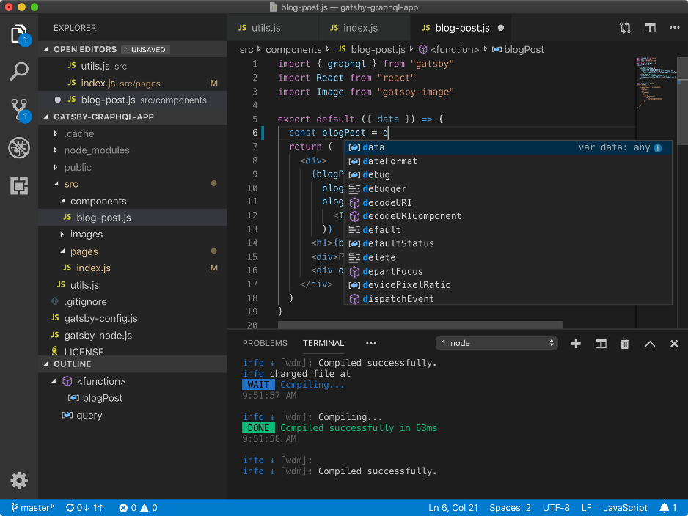
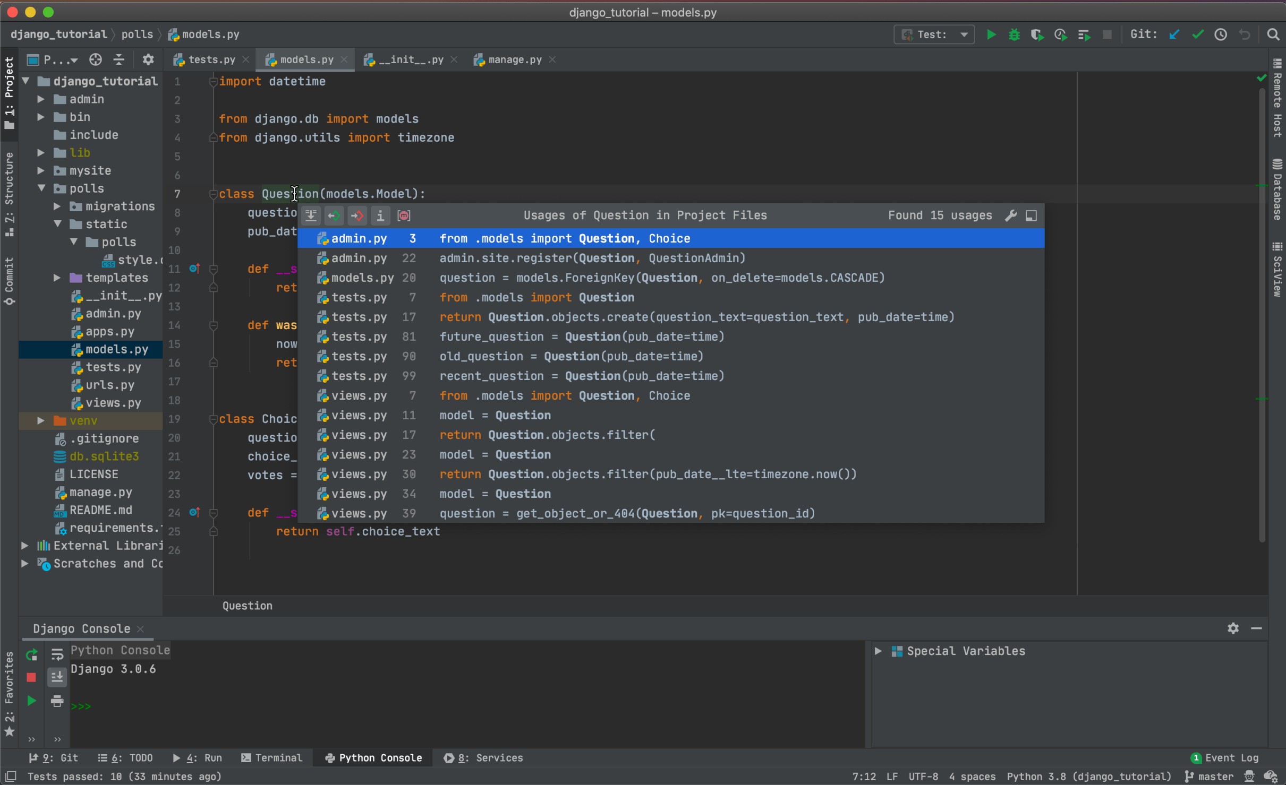
3) IDE or Code Editor
Like Text Editor(Notepad)
Helps to write code
IDE includes a proper environment
Code Editor includes basic tools
IDE heavy
Code Editor lite

Slide 6
4) Data Types
Integer or int
Float
Bool (True or False)
String or str
List or array
Dictionary
Size: 4 bytes Range: -2,147,483,648 to 2,147,483,647
Size: 4 bytes Precision: 6 digits
Size: 1 byte
Size: 1 byte*length of string

Slide 7
5) Execution of code
Top to bottom
Function does not get executed unless called
A variable created inside a scope only works inside the scope
Program can get stuck in a infinite loop
Anything after “return” does not get executed
When passing a variable to a function the function creates a copy of the variable
Variable in different functions can have same names

